Slide 1

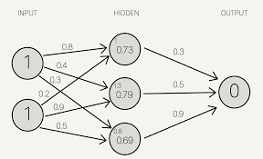
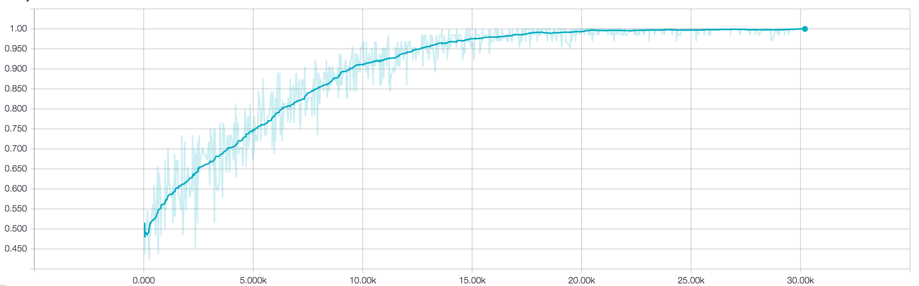
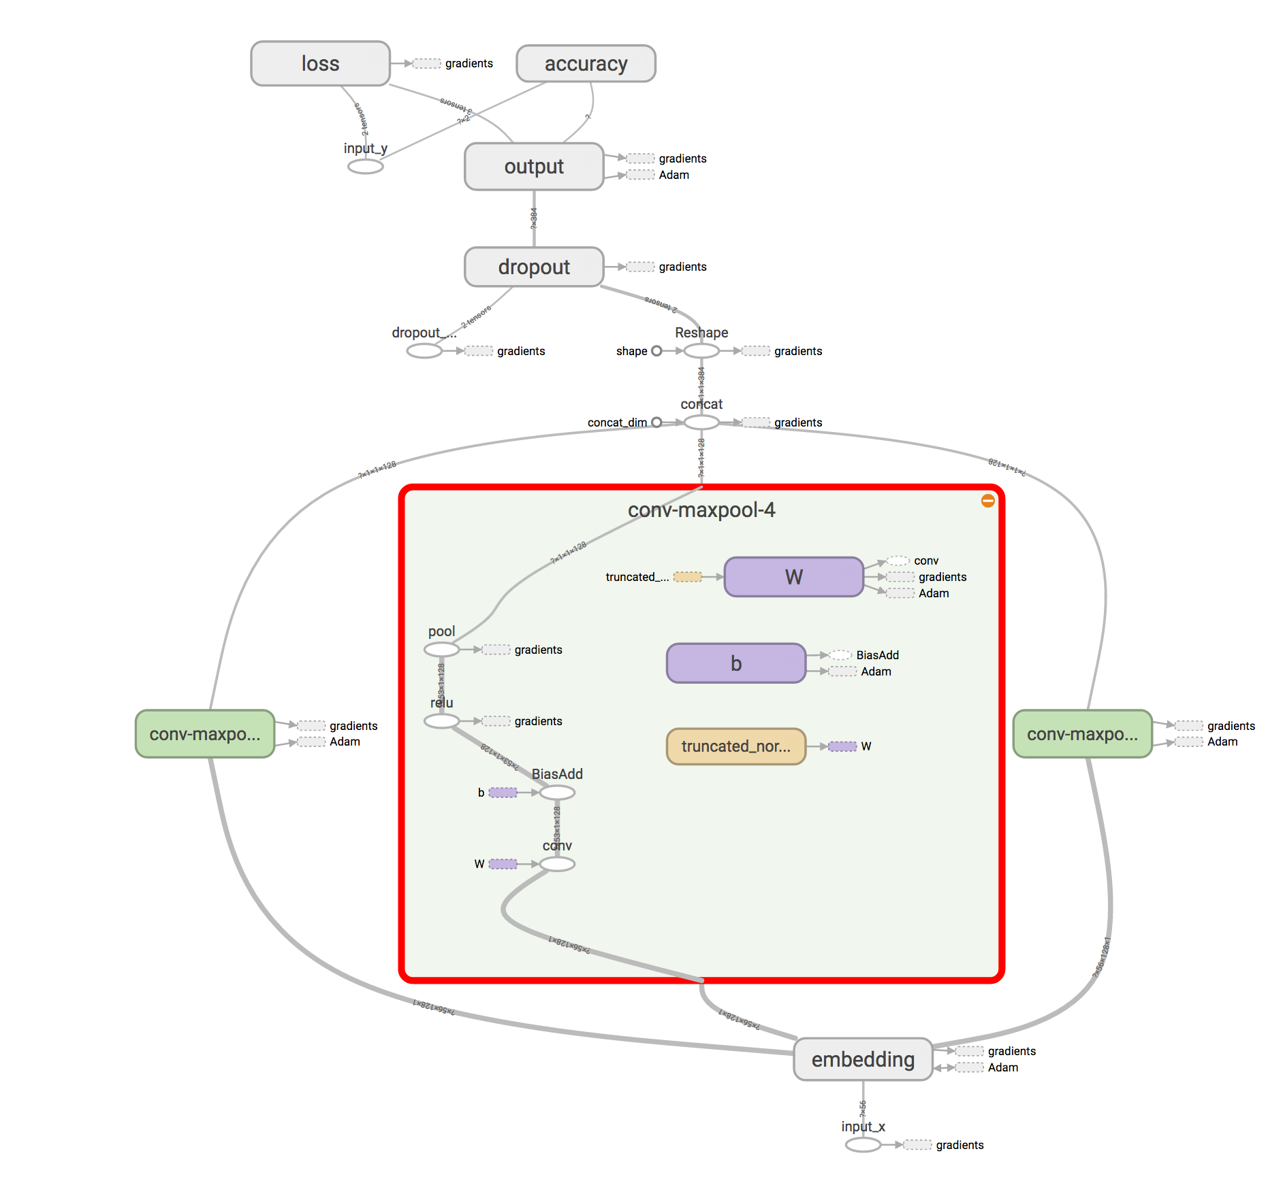
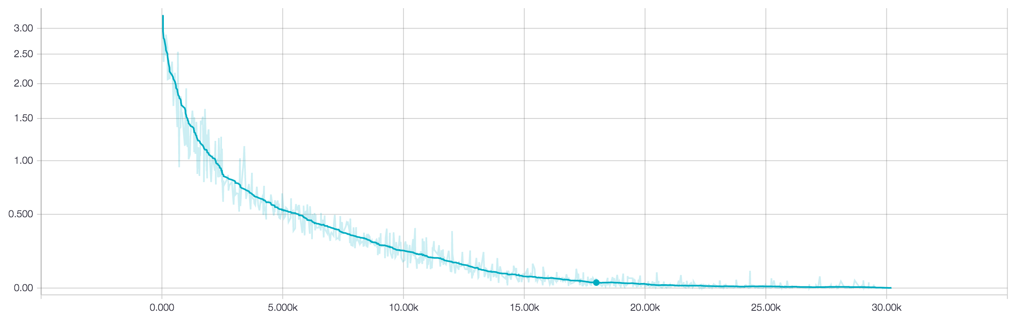
Dynamic Convolutional Neural Networks for Sentiment Analysis
Dylan Siegler
University School, Hunting Valley, Ohio
Research Question
Background
Introduction
The neural network is a recently popularized architecture for a large array of tasks. Although the basic building blocks of neural networks were inspired by what we knew about the neurons in our brain, neural networks in no way resemble the structure of the brain.
A biological neuron takes inputs from other neurons in the form of an electrical charge. The charges from each of the inputs are combined in the nucleus of the neuron and then, only if the charge in the nucleus reaches a certain threshold, the neuron will release some electricity itself. That neuron will act as an input to many other neurons. This large network of neurons is what forms the brain.
Artificial neural networks are much similar. They take inputs in the form of numbers. They sum up all of their inputs and evaluate them on an activation function. The biological neural network’s activation function called a stepper function. There are a number of problems with this activation function for artificial neural networks, including their simplicity and the function’s inability to be fully differentiated. This is why a different class of activation functions is often used. These are called sigmoid functions. They all resemble a stretched out S shape. The most common sigmoid function used in artificial neurons is the hyperbolic tangent function¹.
Now each of the neurons is connected to make an artificial neural network (ANN). First there is an input layer of nodes. These nodes are fed the values that represent the problem. Next each input node leads into each artificial neuron in the hidden layer. The number of neurons in this hidden layer is often determined by a lot of guess and check work. The amount of neurons varies greatly between tasks. The tuning of this parameter along with a number of other parameters involved in training and testing a neural network is often the most time consuming step in building, training, and testing a neural network. As well, each of the connections between the input layer and the hidden layer have a weight associated with it. These weights are what are adjusted and changed during training¹.
Finally each neuron in the hidden layer is connected to every neuron in the output layer. Again these connections have weights associated with them. Once the output layer has evaluated the activation function on their input, they output the answer in numerical form.
The final step in constructing a neural network is the “training.” Through linear algebra the weights connecting neurons are gradually changed to try to find the minimum value of a function. This process is the heart of neural networks, but is also by far the most in-depth. It can take as many as 500 million examples for a neural network to be fully trained. Second, there are many ways to measure how far off from the answer the neural network currently is and many ways to choose which and by how much to adjust weights. As well, a neural network could be “trapped” in a local minimum, not the global minimum. Although a process called dropout can often combat this problem, there are still many other things that can go wrong in training neural networks¹. These layers and weights are combined to form a neural network (Figure 1).
Once the neural network is trained, it can finally be used to perform its intended task. There are many varieties of neural networks that thrive at many different tasks. The simplest neural network is a deep neural network. These neural networks have more than one layer of nodes in them (not counting the output layer). Another very common model is the convolutional neural network (CNN). CNNs focus on the pre-processing of data by repetitively abstracting it into more and more basic forms until they are left with the data in a highly abstract form. This data is then fed into a regular neural network. This pre-processing of the data can make the regular neural network much more effective in its task². A more recent variant of the CNN is called the dynamic-k max pooling convolutional neural network (DCNN). The main difference between a regular CNN and a DCNN is that a DCNN is able to adapt to the size of the input. While the CNN will down sample all of its inputs in order to combat over fitting and speed up training, the DCNN down samples proportional to the size of the input sentence, making it loose less information with long sentences and get less noise with short sentences. There are also recurrent neural networks (RNNs), which use a specialized type of node that has “memory.” This “memory” of what was fed into it recently and what order this information was in allows for RNNs to thrive at tasks that require knowledge of context. Finally, there are a number of successful machine learning models that aren’t neural networks. The most popular non-neural network machine-learning model is the support vector machine (SVM). The SVM tries to find a line that best separates two categories of points. However, because data points are often in many more than two dimensions, an SVM is trying to find a many-dimensional plane (known as a hyper plane) that best separates the two categories of points. The SVM was the dominant model before 2011 and does decently at a variety of tasks, especially classification tasks.³
Does the dynamic k-max pooling convolutional neural network (DCNN) architecture do better than a traditional convolutional neural network (CNN) and a support vector machine (SVM) in the natural language processing task of sentiment analysis.
Despite quickly showing their effectiveness in image processing, convolutional neural networks’ (CNNs) power has yet to be fully exposed in natural language processing (NLP) tasks. Although convolution layers are an very effective abstraction tool, it is believed that one of the main bottlenecks when CNNs work with text is the down sampling done by the max pooling layers. One model that has proven to effectively combat this down sampling is the dynamic-k max pooling convolutional neural network (DCNN), which is able to change the size of the pooling layer based on the size of input sentence. I investigated this model further writing and training a DCNN in TensorFlow, Python, and Theano using short sentences from a dataset of movie and product reviews. As well, as a control wrote a CNN and a support vector machine (SVM), which is a lightweight yet effective primarily mathematical model for classifying words in space. I found that the SVM did surprisingly well with 72.0% accuracy, while the CNN performed with only 71.91% accuracy. The DCNN performed at 85.0% accuracy. These results are clearly indicative of the DCNN’s power in natural language processing tasks.
Hypothesis
The dynamic convolutional neural network will preform slightly better than the convolutional neural network. The support vector machine will preform the worst.
Objectives
Write and test a DCNN, CNN, and SVM on the task of sentiment analysis of sentences/short paragraphs.
Figure 1. An visualization of a small neural network with 2 input nodes, 3 nodes in the hidden layer, and 1 output node³.
Results
Discussion
After training and tuning all three models, I found that the DCNN performed the best. The CNN had an accuracy of 72.0% (Table 1). The dynamic-k max pooling convolutional neural network performed 13% better with an accuracy of 85.0%. As well, the loss and accuracy curves for the training of both the CNN and the DCNN indicate a generally stable training (Figure 2 and Figure 3). The training for both the CNN and the DCNN took about 2 hours on a training of 200 epochs without GPU acceleration. The support vector machine performed with 72% accuracy (Table 1). As well, it had a precision of 89% and recall of 20% of negative test data and a precision of 55% and recall of 97% on positive test data (Table 2). Due to pipelining issues, I was unable to get the precision and recall values (which are representative of how many false positives and “true negatives” the neural networks predicted) for the CNN or the DCNN. The architecture for the DCNN can be seen in Figure 4 with one of the max pooling layers shown in detail. All of the code I used can be found at https://github.com/dsiegler19/dcnn_sentiment_analysis.
My results were generally consistent with my hypothesis. However, the support vector machine actually did slightly better than the convolutional neural network. I believe that this can likely be attributed to the fact I preprocessed the data for the SVM using a count vectorizer and tf-idf. I believe that these two preprocessing steps helped the SVM greatly by removing a lot of noise from the data. Conversely, the lack of data and preprocessing meant that the CNN performed slightly lower than expected. The lack of data combined with the lack of preprocessing meant that not only did the CNN have to learn to ignore noise, but it only a short period of time to do it. On top of this, the CNN didn’t use L2-norm pooling, which meant it was even harder for the CNN to filter out noise. All of these factors combined meant that the CNN performed about 6% lower than expected³.
Even if the CNN had performed at 76% accuracy, the dynamic-k max pooling convolutional neural network would have still performed better. As shown in the original paper, the DCNN’s main strong point is the fact that it can adjust to different size inputs. The max pooling layer typically down samples the data after the convolution layer in order to help prevent over fitting and to help speed up the training of the neural network. However, it down samples both long and short sentences the same amount. This creates inconsistencies since often long sentences are down sampled too much, meaning some data is lost, while short sentences are often down sampled too little, meaning that the neural network is still left with some noise. Although this generally makes little difference for images, which are often the same size, this is very important for sentences, which range from 10 to 100 words³. This size awareness is a large contributing factor in the DCNN’s success in natural language processing tasks.
Table 1. The accuracy of the DCNN, CNN, and SVM architectures. These were calculated using my code, which was written in Python and primarily used TensorFlow and scikit learn.
 | Accuracy
DCNN | 85.00%
CNN | 71.92%
SVM | 72.00%
Table 2. The precision, recall, and F1-Score of the SVM. This SVM was trained using scikit learn’s SVC class.
Conclusion
 | Precision | Recall | F1-Score
Negative | 98% | 20% | 33%
Positive | 55% | 97% | 70%
Average/Total | 72% | 59% | 52%
Despite the DCNN’s success with sentiment analysis due to its ability to adjust to the size of the input sentence, the DCNN still needs to be investigated further in order to prove its superiority over CNNs in other NLP tasks. One major thing that the DCNN lacks in temporal awareness. The DCNN doesn’t care what order the words in a sentence are arranged in. Although this generally doesn’t matter for sentiment analysis, for tasks such as machine translation and question answering this is very important. This is the main reason that the recurrent neural network remains as the champion in these sorts of tasks. This raises the question of whether the DCNN would be able to compete with the RNN in these sorts of tasks, and whether it is possible to blend the 2 models without “overabstracting” data.
As well, my models were fully perfected. For example, I didn’t have time to tune the hyperparameters of all three models fully. If they were tuned, this would likely mean slightly better performance for all 3 models. Furthermore, both the DCNN and the CNN lack L2-norm pooling, which could increase both of their accuracies. Finally, some data preprocessing, primarily using a better encoder for sentences, would help improve the accuracy of both the CNN and the DCNN.
Once I have more refined architectures, I would like to see how well the DCNN does against the RNN in other NLP tasks.
Figure 2. The accuracy of a training run of the DCNN. This accuracy appears exceptionally high due to the fact that it was calculated on the training data, not testing data. This run was 250 epochs long with a batch size of 64. The y axis is accuracy and the x axis is training steps. The graph was generated using TensorFlow’s check pointing feature along with TensorBoard. The graph is smoothed 60% using exponential smoothing.
Materials & Methods
I looked on University of California Irvine website. I found 2 data sets – one of Rotten Tomatoes movie reviews, and one of IMDB movie reviews.
I wrote a basic convolutional neural network (CNN) and a dynamic-k max pooling convolutional neural network (DCNN) in Python 3.5 using TensorFlow 0.110rc0.
The CNN contained an embedding layer. After this, I had filter layers. Each filter layer consisted of a convolution layer, a max pooling layer, and a rectified linear layer. I had 3 filters of size 3, 4, and 5. For each filter I had 128 * filter_size filter layers. Next, I had a dropout layer. For the output layer, I used a softmax to provide probabilities.
The only difference between the CNN and the DCNN was that the size of the pooling layer in the DCNN depended on the size of the input sentence, while the size of the pooling layer was static in the CNN.
Next I wrote a support vector machine. I used scikit-learn 0.18’s Support Vector Classifier (sklearn.svm.SVC). I preprocessed the text using a count vectorizer and tf-idf.
Finally, I trained all 3 of the architectures using the Rotten Tomatoes movie review corpus for training data and the IMDB movie reviews corpus for testing.
I used TensorFlow’s checkpoint feature as well as TensorBoard to generate graphs for loss as well as the visualization of the architectures.
Acknowledgements &
References
Figure 3. The loss of a training run of the DCNN. This run was 250 epochs long with a batch size of 64. The y axis is loss (calculated using softmax cross entropy) and the x axis is training steps. The graph was generated using TensorFlow’s check pointing feature along with TensorBoard. The graph is smoothed 60% using exponential smoothing.
I would like to thank Dr. Laux, Mr. Sweeney, Professor Edward Grefenstette, and my parents for their help and support.
Haykin, Simon S. Neural Networks: A Comprehensive Foundation. New York: Macmillan, 1994.
Arpathy, K. "CS231n Convolutional Neural Networks for Visual Recognition." CS231n Convolutional Neural Networks for Visual Recognition. Accessed October 30, 2016. http:// cs231n.github.io/convolutional-networks/.
Kalchbrenner, Nal, Edward Grefenstette, and Phil Blunsom. "A Convolutional Neural Network for Modelling Sentences." Proceedings of the 52nd Annual Meeting of the Association for Computational Linguistics (Volume 1: Long Papers), 2014. doi:10.3115/v1/p14-1062.
Anguita, D., A. Boni, and S. Ridella. "A Digital Architecture for Support Vector Machines: Theory, Algorithm, and Fpga Implementation." IEEE Transactions on Neural Networks 14, no. 5 (2003): 993-1009. Accessed October 30, 2016. doi:10.1109/tnn.2003.816033.
Miller, Steven. Digital image. Http://stevenmiller888.github.io. August 10, 2015. Accessed October 30, 2016. http://stevenmiller888.github.io/mind-how-to-build-a-neural-network/.
Figure 4. This is the DCNN architecture I used. I have selected 1 of the 3 max pooling layers to show it in more detail. This graph was generating using TensorFlow’s summary feature along with TensorBoard.

